Slide 1


Operating System (114 Autumn)
Chun-Feng Wu (吳俊峯)
Assistant Professor, National Yang Ming Chiao Tung University
cfwu417@cs.nycu.edu.tw
https://cfwu417.github.io

Slide 2
Remind– Paper Presentation
Should join online when you need to do the presentation.
https://nycu.webex.com/meet/cfwu417
Welcome everyone to join paper presentations online every Friday.
What do we expect for the presentation (6-8min):
Background, Trend (~2min)
Related Works & Observation & Motivation (~2min)
Methodology Concepts (~3min)
Criteria:
Make the motivation clear enough. (Organize the flow from background to related works and to challenges clear)
Let the presentation easy-to-follow. (Some animations can help.)
Point out the design concept of the methodology? (Do not go through the algorithm, please extract the high-level concept.)
Do not let the presentation go over 8 mins

Slide 3
L1: Operating Systems a Recap
Notes:
Good Morning, My name is Chun-Feng Wu. In this presentation, I will briefly introduce myself and share some key idea of my researches.
Intensive data movement is one of the critical issue when Von-Neumann machines enter the big data era.
To deal with this issue, my research is to enable a fast, large and device-friendly next-generation computing system.

Slide 4
Agenda
Computer System Organization
What is Operating Systems & Linux Kernel
Operating System Structure
What topics will we cover
Process & Interrupts
Main Memory Management
I/O Devices & Device Driver
File System
Challenge of OS
Advance Topics: Graph Systems, Deep Recommendation System, Key-Value Database, Deduplication, Data Center Computing, Virtualization Concepts
Notes:
This is the agenda.
I will first give a brief self-introduction including awards, cooperation experiences, and publication.
After that, I will give a deep dive into my research – the next-generation computing system, and present my future plan.
I will then talk about the reason for applying your department, as well as my course plan in the end of presentation.

Slide 5
Computer Organization
Introduction: Computing devices, memory devices (e.g., DRAM), and I/O devices (e.g., HDD, SDD, or network devices) are three main basic components.
Software: The collection of programs, data, and instructions.
Von-Neumann Architecture:
CPU fetches an instruction from memory.
Then, CPU decodes and executes the instruction.
CPU fetches next data (Automatically Increment PC).
Challenges without Operating Systems:
CPU will be solely occupied by one process.
CPU shall wait for I/O devices. (1 ns vs 100 us).
CPU cannot understand ”file” in I/O devices.
Compute (e.g., CPU)
Control Unit
ALU
PC
Inst 1
PC
PC
Inst 2
Inst 3
Memory (e.g., DRAM, NVM)
.
.
.
Sol: Process Scheduler
I/O (e.g., HDD, SSD)
Sol: Page Fault Handler & Context Switch
Sol: Device Driver & File System
CPU only does routine work!

Slide 6
Roles of Operating System (OS)
Goal: A software layer (middleware) stands between applications and computer’s hardware. The role of an OS is to coordinate and manage hardware devices. (e.g., CPU, memory, storage devices).
OS’s Roles:
Transparency: Users do not need to worry about hardware managements or contentions.
Resource Allocator: Manage CPU time, memory space and I/O resources.
Control Program: Prevent errors and improper use of computers.
Neural Networks
Web Browsers
Video Players
Control Program
Operating System
Resource Allocator
Computer Hardware
Computing Devices
Memory Devices
I/O Devices

Slide 7
Roles of Operating System (Count.)
Goal: A software layer (middleware) stands between applications and computer’s hardware. The role of an OS is to coordinate and manage hardware devices. (e.g., CPU, memory, storage devices).
Well-Known Components:
Process Scheduler: Fairly allocate CPU resources to applications.
Memory Manager: Allocate memory, locate pages, reclaim memory.
Block I/O Layer: Manage I/O requests (Merge & Schedule I/O)
File System: Locate file contents, partition devices, control permission.
Neural Networks
Web Browsers
Video Players
Operating System
Process Scheduler
Memory Manager
File System
Block I/O Layer
Computer Hardware
Computing Devices
Memory Devices
I/O Devices

Slide 8
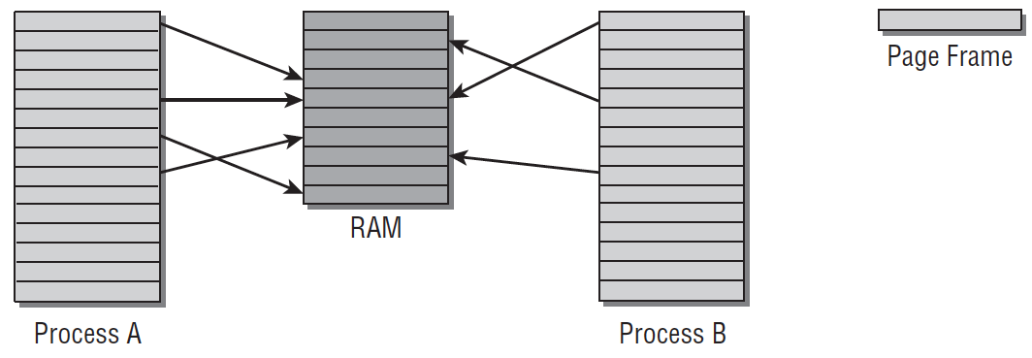
What is Linux Kernel
Linux Kernel: A process manager consists of a bunch of C and Assembly code.
Is Linux Kernel a Process: No, Not exactly.
Each process shall have their own virtual address space.
Virtual address space makes programming easier!
Fixed size (e.g., 4KB) solves fragmentation!
Page
Page
Table
Page Frame (4KB)
Data
Process B doesn’t need to know the data is swapped! So no code is changed.
Non-Present
Swap!
Physical Address Space
Change B’s page table.
pte_to_swap_entry()
Virtual Address Space
Virtual Address Space
Storage (e.g., HDD, SSD)

Slide 9
What is Linux Kernel (Count.)
Linux Kernel: A process manager consists of a bunch of C and Assembly code.
Is Linux Kernel a Process: No, Not exactly.
Each process shall have their own virtual address space.
Page
Page
Table
Page Frame (4KB)
Kernel Address Space (Virtual)
User Program
User Address Space (Virtual)
Physical Address Space
Virtual Address Space
Virtual Address Space
Process Data
Main Memory

Slide 10

What is Linux Kernel (Count.)
Linux Kernel: A process manager consists of a bunch of C and Assembly code.
Is Linux Kernel a Process: No, Not exactly.
Each process shall have their own virtual address space.
Kernel runs as part of a user process. (Noting: A specific part of all processes’ virtual address space points to the same physical address storing kernel code.)
There are also some kernel processes working on monitoring system status. (Daemon)
Kernel Address Space (Virtual)
Page Fault Handler
CPU
Page Fault!!
User Mode
Kernel Mode
User Program
User Address Space (Virtual)
Process A
User Mode
Kernel Mode
Noting: CPU switches to kernel mode to access OS code. But, CPU does not need to switch the context!
Process Data
Process A
Main Memory

Slide 11

How to Trigger/Request Kernel Services
When Do CPUs Run Kernel: CPUs runs the kernel only when some special events are triggered. Otherwise, it runs user programs or stays idle.
Special Events:
Hardware interrupts (Alerting signal)
Timer interrupt
I/O Interrupt (e.g., Keyboard, Hard Disks)
Software-generated interrupts (Traps or Exceptions)
Specific requests from user processes (System Call, such as Read/Write)
Some errors (e.g., invalid memory access or page faults)
System Call
Timer Interrupt
Context Switch
I/O Interrupt
User Mode
Process A
Process A
Process B
Kernel Mode
System Call Handler
Scheduler
I/O Handler
Scheduler

Slide 12
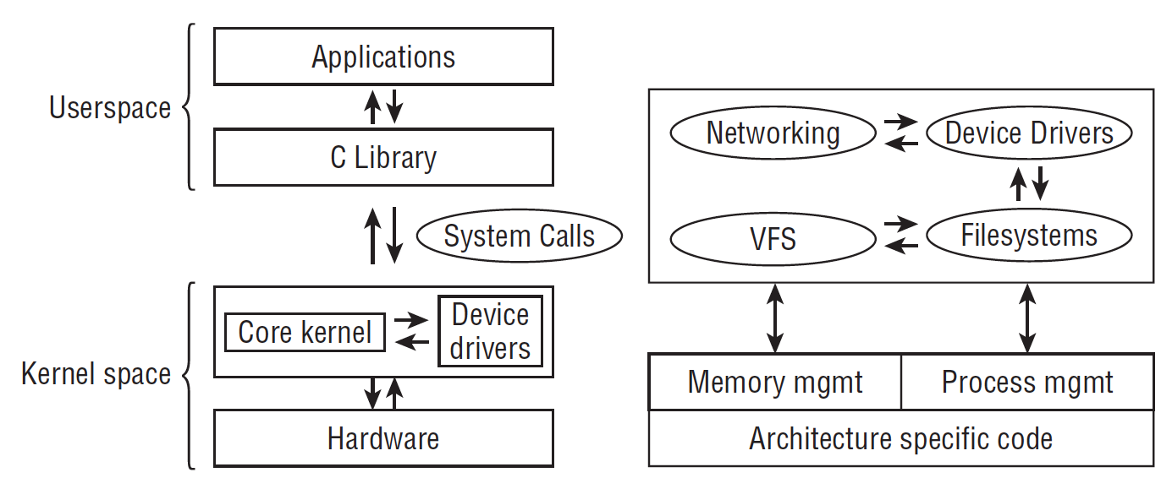
Put it all together: A High-Level Overview
User Space:
Applications (e.g., TensorFlow, Hadoop, Databases, Pytorch)
Libraries (e.g., C/C++ Library 🡪 Does Memory Allocation )
Kernel Space:
Device Drivers (Contact with I/O devices)
Core Kernel
Process Management
Memory Management
I/O Management
A High-level Overview of the Linux Kernel^{[1]}
[1] Mauerer, Wolfgang. Professional Linux kernel architecture. John Wiley & Sons, 2010

Slide 13
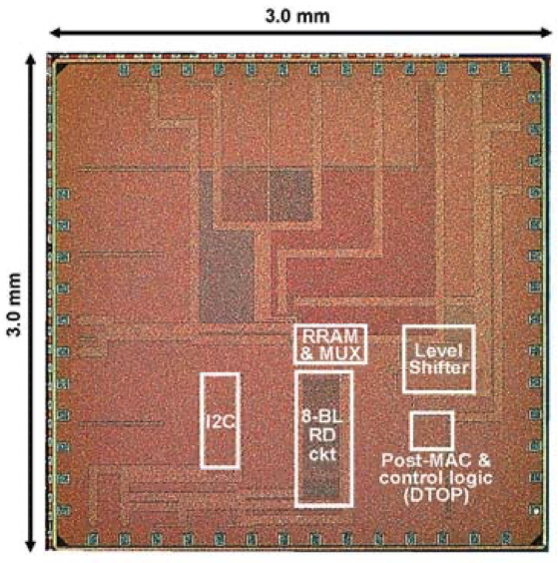
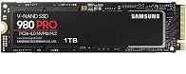
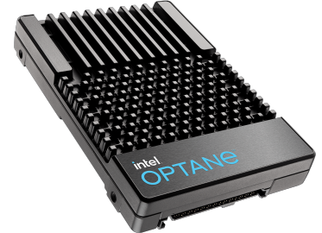
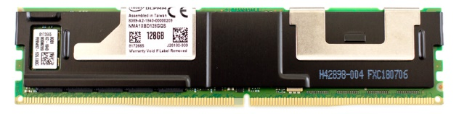

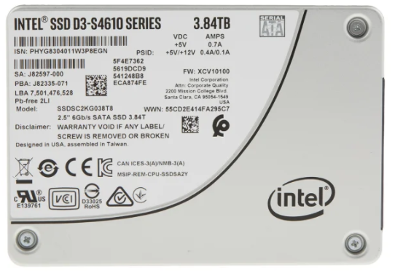
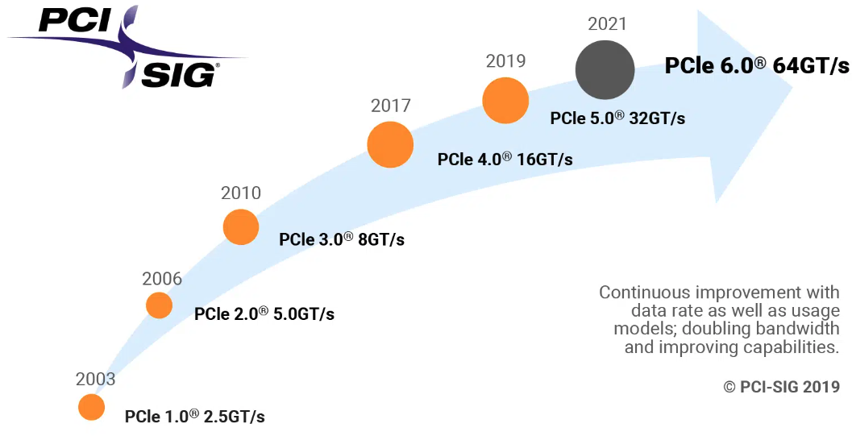
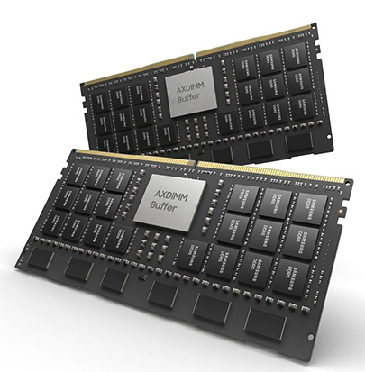
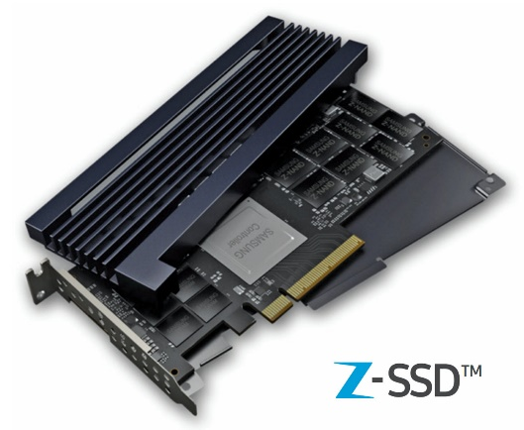
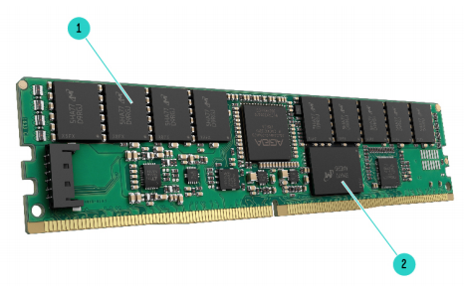
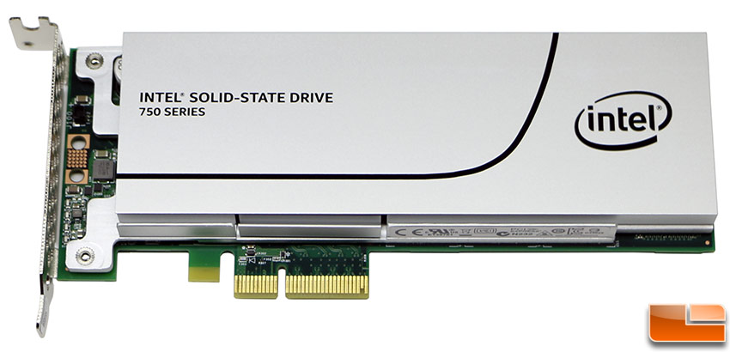
Emerging I/O Technologies
NVMe M.2 SSD
Intel Optane DC
Persistent Memory
Intel Optane SSD
TSMC PIM Chips
NVMe U.2 SSD
DRAM
NAND Flash
NVMe PCIe SSD
Samsung Z-NAND SSD
HPE NVDIMM
Samsung AXDIMM
High Throughput
3.98 GB/s
Ultra-Low Latency
~ 5 us
Storage-Class
Memory
Faster Data Buses
2011
2017
Now
Notes:
Fortunately, enterprises have launched several emerging devices to deal with the challenge of data movements.
In 2011, Intel initiated the first NVMe protocol to improve the throughput of peripheral buses.
(click)
In 2017, Samsung and Intel launched ultra-low-latency SSDs.
Their access latency can reach around 5 microseconds, which is ten times faster than common SSDs. By the way, the time of running some OS functions is also around 5 microseconds.
(click)
Under the trend of high throughput and ultra-low-latency, the performance gap between storage and memory devices is shrinking quickly.
So, enterprises like intel and HPE propose storage-class memory devices by placing storage devices on the DIMM memory module, so as to strike a balance between price and performance.
(click)
As the manufacturing technology becomes mature, some memory devices start to support processing capability. For example, TSMC proposes a memory chip and Samsung launches their AXDIMM devices.
Both devices can support processing-in-memory
However, due to the manufacturing limitation, and the outdated design of operating system, we might still face some critical challenges while using these devices.
說法材料：
A 40nm 64Kb 56.67TOPS/W Read-Disturb-Tolerant Compute- in-Memory/Digital RRAM Macro with Active-Feedback-Based Read and In-Situ Write Verification
https://cc.cnetcontent.com/vcs/hp-ent/inline-content/SI/C/2/C2B3385377589DDEF3AC5CE77AA40BE213B401C2_source.PDF
除了DRAM之外，非揮發性記憶體NVM被視為擴充主記憶體的候選。
主要原因是NVM技術近10年來有著顯著的發展，其中快閃記憶體NAND Flash的發展最為成熟 以價格來說，NAND Flash相較於DRAM可以節省三十倍甚至四十倍的價格，此外由於製成的不同，NAND Flash已經可以提供TB等級的容量
然而，僅管NAND Flash的存取速度在近幾年有的大福度的提生，相較於DRAM的50ns來說還是存在不小的performance gap.因此以NAND Flash支援主記憶體延伸 performance還是一大關鍵

Slide 14
System Trend – Rethinking OS
The device trend blurs the boundary between memory and storage.
Storage response time catches up with context switch overhead (1~10 us).
The overhead of running file system becomes critical (e.g., page cache).
Huge memory demands increases deployment cost. (Right page size?)
Cache TLB (SRAM)
1~10ns
10x
Memory (DRAM)
10~100ns
10x
NVM, ULL Devices (PCM, Samsung ZNAND)
> 1000x
100ns ~ 10 us
OS Management (100ns ~10us)
Storage (HDD, SSD)
100us ~ 1ms

Slide 15
Agenda
Computer System Organization
What is Operating Systems
A High-Level Overview
What topics will we cover
Process & Interrupts
Main Memory Management
I/O Devices & Device Driver
File System
Close to Applications: Graph Systems, Deep Recommendation Systems, Key-Value Databases, Virtualization Concepts

Slide 16
Process & Interrupt
Process
What is a Process, Process Descriptor, Process State Diagram (Process’s Life Cycle)
Multiprogramming and Multitasking, Context Switch
CPU Scheduling:
Priority, Time Slice
O(N) (Linux 2.4 ~ 2.6)
O(1) SCHED_Normal (Linux releases 2.6.0 thru 2.6.22 )
Completely Fair Scheduler (CFS) (After Linux 2.6.22)
Real-Time Scheduling
Interrupts:
Software Interrupt: How system call works. Also, how to implement it.
Hardware Interrupt: How interrupt handler (or interrupt service routine) works.
Advance Research Topics:
(1) Rethink context switch
(2) Rethink process state diagram

Slide 17
Main Memory Management
Page
Page
Table
Page Frame (4KB)
Physical Memory
Physical Memory Allocation (Buddy System)
Slab Layer
Virtual Memory
Paging (Page Table Walk), Huge Page
Page Fault Handler
Page Replacement (LRU and others)
Swapping
Memory Hierarchy (Cache vs Memory vs Storage)
Design concerns for each layer
Non-Uniform Memory Access (NUMA)
Advance Research Topics:
(1) Main Memory Extension
(2) Rethink page size
(3) Rethink page fault handler
Physical Address Space
Virtual Address Space
Virtual Address Space
Cache (SRAM)
Memory (DRAM)
NUMA
Storage (HDD, SSD)
[1] Mauerer, Wolfgang. Professional Linux kernel architecture. John Wiley & Sons, 2010

Slide 18
I/O Devices & I/O Systems
Process
How data stored in I/O devices:
NAND-Flash-based Solid State Drive (SSD)
Hard Disk Drive (HDD)
Shingled Magnetic Drive (SMR)
Device Driver
More about interrupts: Top-Halves vs Bottom-Halves
How to write a device driver
Block I/O Layer
What is BIO
Merge and Coalesce I/O Operations
I/O Scheduler
Advance Topic:
NVMe Protocol
Device Mapper
sys_read()
sys_write()
User
Kernel
Virtual File System
Page Cache
Mapping Layer (FS Specific)
Block I/O Layer
Block Device Driver
Devices
(e.g., HDD, SSD)
http://byteliu.com/2019/05/10/Linux-The-block-I-O-layer/
Notes:
http://byteliu.com/2019/05/10/Linux-The-block-I-O-layer/
https://www.oreilly.com/library/view/understanding-the-linux/0596005652/ch14s03.html
https://www.seagate.com/files/www-content/product-content/ssd-fam/nvme-ssd/nytro-xf1440-ssd/_shared/docs/an-introduction-to-nvme-tp690-1-1605us.pdf
https://www.linuxjournal.com/article/8110
The I/O Scheduler
Although block device drivers are able to transfer a single sector at a time, the block I/O layer does not perform an individual I/O operation for each sector to be accessed on disk; this would lead to poor disk performance, because locating the physical position of a sector on the disk surface is quite time-consuming. Instead, the kernel tries, whenever possible, to cluster several sectors and handle them as a whole, thus reducing the average number of head movements.
When a kernel component wishes to read or write some disk data, it actually creates a block device request. That request essentially describes the requested sectors and the kind of operation to be performed on them (read or write). However, the kernel does not satisfy a request as soon as it is created—the I/O operation is just scheduled and will be performed at a later time. This artificial delay is paradoxically the crucial mechanism for boosting the performance of block devices. When a new block data transfer is requested, the kernel checks whether it can be satisfied by slightly enlarging a previous request that is still waiting (i.e., whether the new request can be satisfied without further seek operations). Because disks tend to be accessed sequentially, this simple mechanism is very effective.
Deferring requests complicates block device handling. For instance, suppose a process opens a regular file and, consequently, a filesystem driver wants to read the corresponding inode from disk. The ...

Slide 19
File System
Process
Virtual File System
File System
Organization (Files & Directories)
Interface (Functions)
Page Cache
Cache Eviction (Linux Two-List Strategy)
The Flusher Threads
Memory Mapping (mmap)
Advance Research Topic:
In-Memory File System
sys_read()
sys_write()
User
Kernel
Virtual File System
Page Cache
Mapping Layer (FS Specific)
Block I/O Layer
Block Device Driver
Devices
(e.g., HDD, SSD)

Slide 20
Applications (Optional)
Graph Systems
How to run graph system on personal computer (GraphChi)
How to process dynamic graph (GraphOne)
Deep Recommendation System
General Recommendation System (Facebook DLRM)
GNN-based Social Recommendation System (Jindong GraphRec)
Key-Value Database (For Storage)
Log-Structured Merged (LSM) Database (Google)
LSM on SSDs (WiscKey)
Learned Index
Data Center (Cloud) Computing
Data Deduplication
In-memory File System
Distributed File System (Ceph)
Virtualization Concepts

Slide 21


Thanks for your attention Q & A
Notes:
Thanks for your listening

